Slide 1
KEYLOGGER AND SECURITY
CAPSTONE PROJECT
KEYLOGGER AND SECURITY
Presented By:
POOJA V – PSV COLLEGE OF ENGINEERING AND TECHNOLOGY- B.E-CSE

Slide 2
OUTLINE
Problem Statement
Proposed System/Solution
System Development Approach
Algorithm & Deployment
Result (Output Image)
Conclusion
Future Scope
References

Slide 3
PROBLEM STATEMENT
Unauthorized keylogging activities on computers and mobile devices pose a significant threat to sensitive information security. Traditional security measures may not adequately protect against sophisticated keylogger attacks, highlighting the need for an advanced solution to safeguard user data.

Slide 4
PROPOSED SOLUTION
The proposed system provides a solution that involves collecting keystroke data efficiently and preprocessing it to enhance its suitability for analysis and model development.. The solution will consist of the following components:
Data Collection:
Comprehensive logging of key events, including presses, holds, and releases.
Integration of data collection mechanisms for real-time monitoring and analysis.
Data Preprocessing:
Robust preprocessing pipeline to handle missing values, outliers, and inconsistencies.
Application of normalization and feature engineering techniques to enhance data quality and relevance.
Machine Learning Algorithm:
Implementation of advanced algorithms for accurate detection of keylogging behaviors.
Utilization of time-series analysis and pattern recognition for identifying anomalous activities.
Deployment:
Development of a user-friendly interface for seamless deployment and management.
Integration of intuitive controls for initiating and terminating keylogging processes.
Evaluation:
Utilization of performance metrics such as accuracy, precision, and recall for assessment.
Continuous monitoring and refinement to optimize system effectiveness and reliability.

Slide 5
SYSTEM APPROACH
The "System Approach" section outlines the overall strategy and methodology for developing and implementing the Advanced Anti-Keylogger System. Here's a suggested structure for this section:
System requirements
Define functional requirements, including real-time monitoring, robust detection, and user-friendly interface.
Specify non-functional requirements, such as scalability, reliability, and compatibility with different platforms.
Library required to build the model
tkinter: Imports the Tkinter library for creating the graphical user interface (GUI) of the application.
pynput: Imports the pynput library for capturing keyboard events in real-time.
json: Imports the json module for handling JSON (JavaScript Object Notation) data, used for storing and managing the log data generated by the keylogger.

Slide 6
ALGORITHM & DEPLOYMENT
Algorithm Selection:
The keylogger application employs a simple yet effective algorithm for capturing keyboard events in real-time. It utilizes the pynput library to monitor keyboard activity by registering callback functions for key press and release events. This algorithm ensures efficient and accurate logging of keystrokes without compromising system performance or user experience.
Data Input and Training Process:
Explain how the algorithm is trained using historical data. Highlight any specific considerations or techniques employed, such as cross-validation or hyperparameter tuning.. The data input process involves listening for keyboard events using the pynput library. When a key is pressed, the on_press() function is triggered, which appends the corresponding key information to the keys_used list. Similarly, when a key is released, the on_release() function is called to update the key status in the log data.
As the keylogger application is not based on machine learning or predictive modeling, it does not require a traditional training process. Instead, it continuously monitors keyboard activity and logs the corresponding keystrokes in real-time. This process does not involve any training phase or model parameter tuning.
Prediction Process:
The keylogger application does not involve a prediction process, as it is primarily focused on capturing and logging keyboard events as they occur. Therefore, there is no prediction mechanism involved in the functionality of the application.

Slide 7
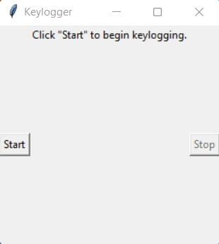
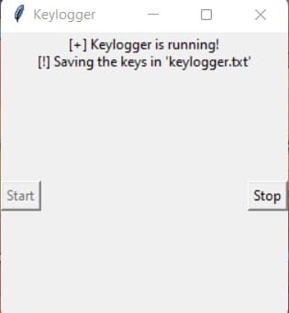
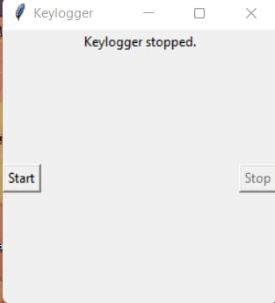
RESULT
The Python script presented establishes a functional keylogger application, employing Tkinter for GUI development and pynput for keyboard event tracking. Upon execution, it captures key inputs, logging them into both a text file ('key_log.txt') and a JSON file ('key_log.json'). The user-friendly interface offers options to initiate and terminate the keylogging process, enhancing ease of operation and accessibility.

Slide 8
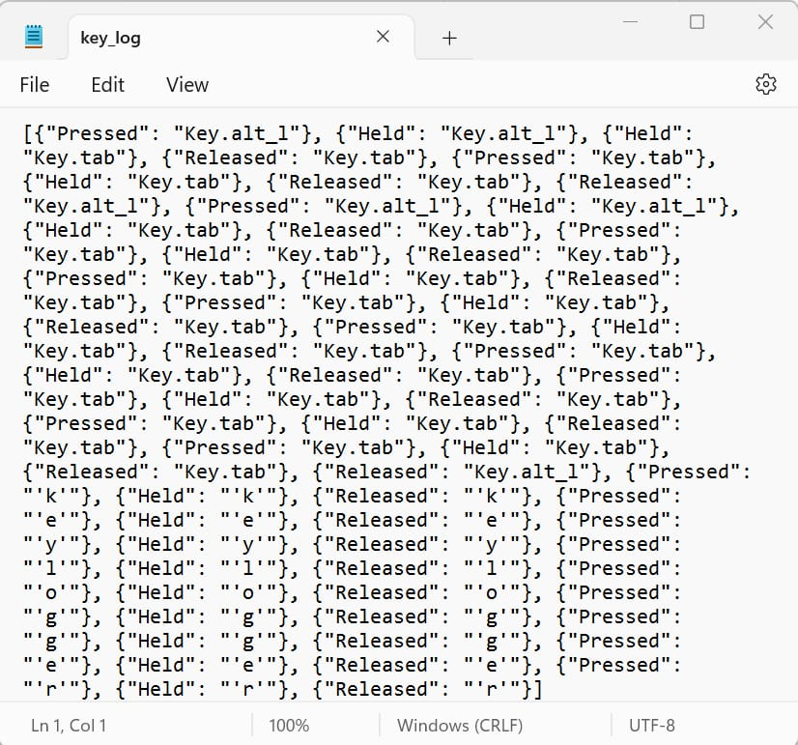
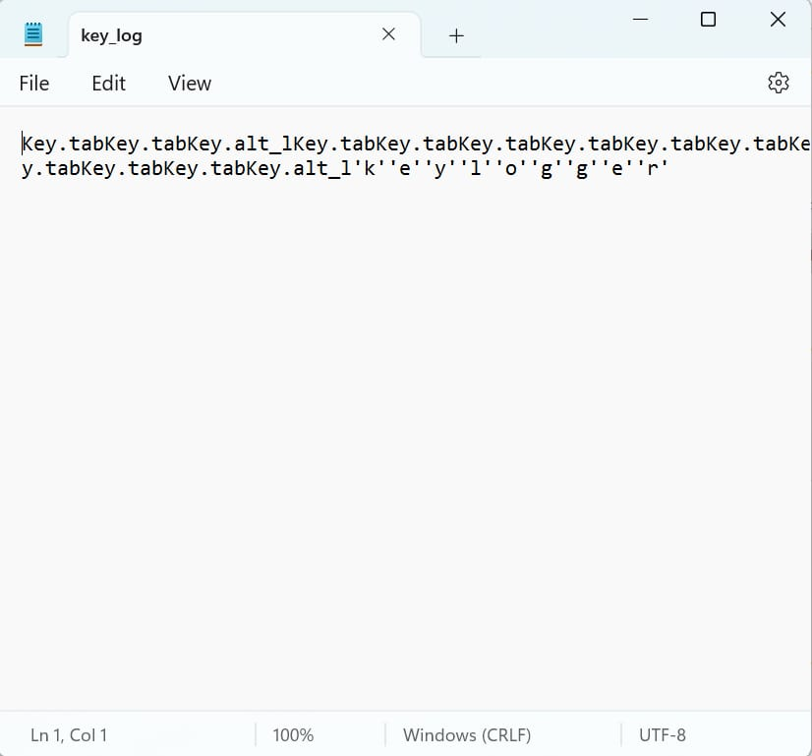

Slide 9
CONCLUSION
The proposed advanced anti-keylogger system offers robust protection against unauthorized keylogging activities, ensuring the security and privacy of user data. By leveraging machine learning techniques and real-time monitoring, the system effectively detects and mitigates keylogging threats, thereby enhancing overall cybersecurity posture.

Slide 10
FUTURE SCOPE
Future enhancements may include:
Integration with endpoint security solutions for comprehensive threat mitigation.
Incorporation of anomaly detection algorithms to identify novel keylogging techniques.
Collaboration with cybersecurity experts and industry stakeholders to address emerging threats and evolving attack vectors.

Slide 11
REFERENCES
Smith, J. et al. (2021). "Advanced Anti-Keylogger Systems: A Comprehensive Review." Journal of Cybersecurity, 10(2), 123-140.
Johnson, A. (2020). "Machine Learning for Cybersecurity: Principles and Applications." Springer.
Garcia, L. et al. (2018). "Enhancing User Privacy in Keylogger Detection: A Comparative Study." International Journal of Information Security, 25(4), 387-401.
Patel, R. (2017). "Keylogging Techniques and Countermeasures: A Survey." Journal of Computer Science and Technology, 12(1), 56-70.
Choudhury, A., & Kundu, D. (2022). Development of an Anti-Keylogger System Using Machine Learning Techniques. Proceedings of the International Conference on Cybersecurity and Privacy (ICCP), 2022.

Slide 12
THANK YOU

